Slide 1
About Me
Ritesh Singh
Sun Certified java Professional
Oracle Certified Database Administrator
Certified Ethical Hacker
Certified EC-Council Instructor (CEI)

Slide 2
Course Overview
Introduction to MySQL derived table

Slide 3
A derived table is a virtual table returned from a SELECT statement. A derived table is similar to a temporary table, but using a derived table in the SELECT statement is much simpler than a temporary table because it does not require steps of creating the temporary table.
The term derived table and subquery is often used interchangeably. When a stand-alone subquery is used in the FROM clause of a SELECT statement, it is called a derived table.

Slide 4
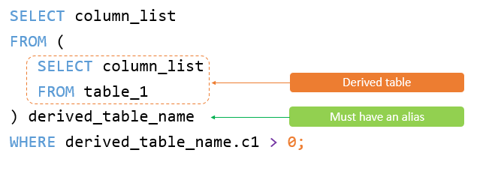
The following illustrates a query that uses a derived table:

Slide 5
Note that a stand-alone subquery is a subquery that can execute independently of the statement containing it.
Unlike a subquery, a derived table must have an alias so that you can reference its name later in the query. If a derived table does not have an alias, MySQL will issue the following error:
Every derived table must have its own alias.

Slide 6
The following illustrates an SQL statement that uses a derived table:
SELECT
column_list
FROM
(SELECT
column_list
FROM
table_1) derived_table_name;
WHERE derived_table_name.c1 > 0;

Slide 7
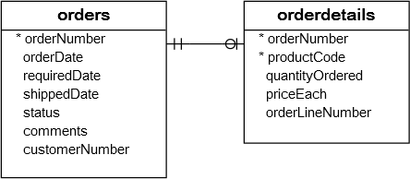
A simple MySQL derived table example
The following query gets the top 5 products by sales revenue in 2003 from the orders and orderdetails tables in the sample database:

Slide 8
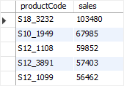
SELECT
productCode,
ROUND(SUM(quantityOrdered * priceEach)) sales
FROM
orderdetails
INNER JOIN
orders USING (orderNumber)
WHERE
YEAR(shippedDate) = 2003
GROUP BY productCode
ORDER BY sales DESC
LIMIT 5;

Slide 9
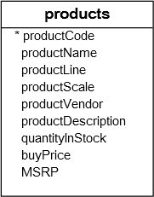
You can use the result of this query as a derived table and join it with the products table as follows:

Slide 10
SELECT
productName, sales
FROM
(SELECT
productCode,
ROUND(SUM(quantityOrdered * priceEach)) sales
FROM
orderdetails
INNER JOIN orders USING (orderNumber)
WHERE
YEAR(shippedDate) = 2003
GROUP BY productCode
ORDER BY sales DESC
LIMIT 5) top5products2003
INNER JOIN
products USING (productCode);

Slide 11
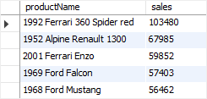
The following shows the output of the query above:

Slide 12
In this example:
First, the subquery is executed to create a result set or derived table.
Then, the outer query is executed that joined the top5product2003 derived table with the products table using the productCode column.

Slide 13
A more complex MySQL derived table example
Suppose you have to classify the customers who bought products in 2003 into 3 groups: platinum, gold, and silver. And you need to know the number of customers in each group with the following conditions:
Platinum customers who have orders with the volume greater than 100K
Gold customers who have orders with the volume between 10K and 100K
Silver customers who have orders with the volume less than 10K

Slide 14
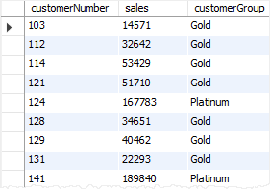
To construct this query, you first need to put each customer into the respective group using CASE expression and GROUP BY clause as follows:
SELECT
customerNumber,
ROUND(SUM(quantityOrdered * priceEach)) sales,
(CASE
WHEN SUM(quantityOrdered * priceEach) < 10000 THEN 'Silver'
WHEN SUM(quantityOrdered * priceEach) BETWEEN 10000 AND 100000 THEN 'Gold'
WHEN SUM(quantityOrdered * priceEach) > 100000 THEN 'Platinum'
END) customerGroup
FROM
orderdetails
INNER JOIN
orders USING (orderNumber)
WHERE
YEAR(shippedDate) = 2003
GROUP BY customerNumber;

Slide 15
Then, you can use this query as the derived table and perform grouping as follows:
SELECT
customerGroup,
COUNT(cg.customerGroup) AS groupCount
FROM
(SELECT
customerNumber,
ROUND(SUM(quantityOrdered * priceEach)) sales,
(CASE
WHEN SUM(quantityOrdered * priceEach) < 10000 THEN 'Silver'
WHEN SUM(quantityOrdered * priceEach) BETWEEN 10000 AND 100000 THEN 'Gold'
WHEN SUM(quantityOrdered * priceEach) > 100000 THEN 'Platinum'
END) customerGroup
FROM
orderdetails
INNER JOIN orders USING (orderNumber)
WHERE
YEAR(shippedDate) = 2003
GROUP BY customerNumber) cg
GROUP BY cg.customerGroup;

Slide 16

The query returns the customer groups and the number of customers in each.

Slide 17
Thank You
Please Subscribe My Channel
https://www.youtube.com/channel/UCYW3PWPOPn3qgxxjhUbXXXg?view_as=subscriber

